Slide 1
Alcohol Consumption
Group 10 Members: Abdellah Hady, Andrew Miller, Emmanuel Nnamdi Obodoechine, Taylor Sperry, William Jung

Slide 2
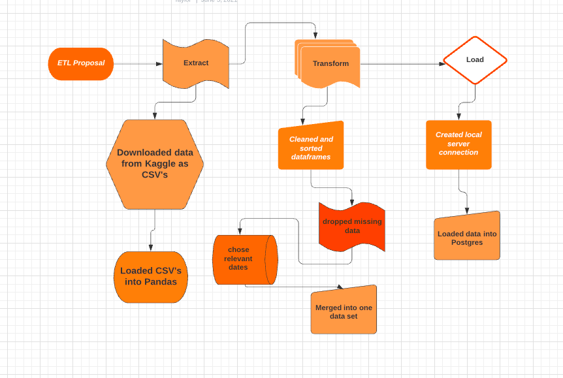

Slide 3
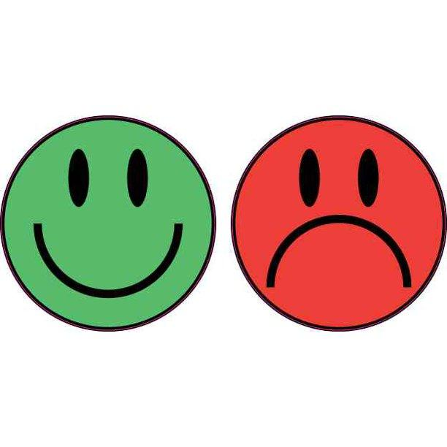
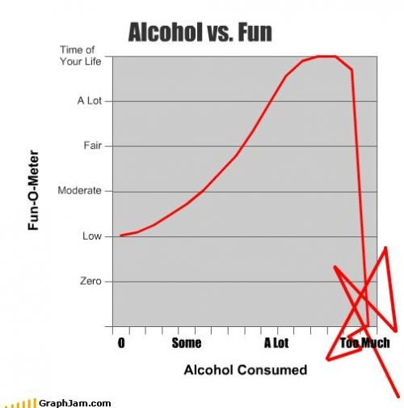
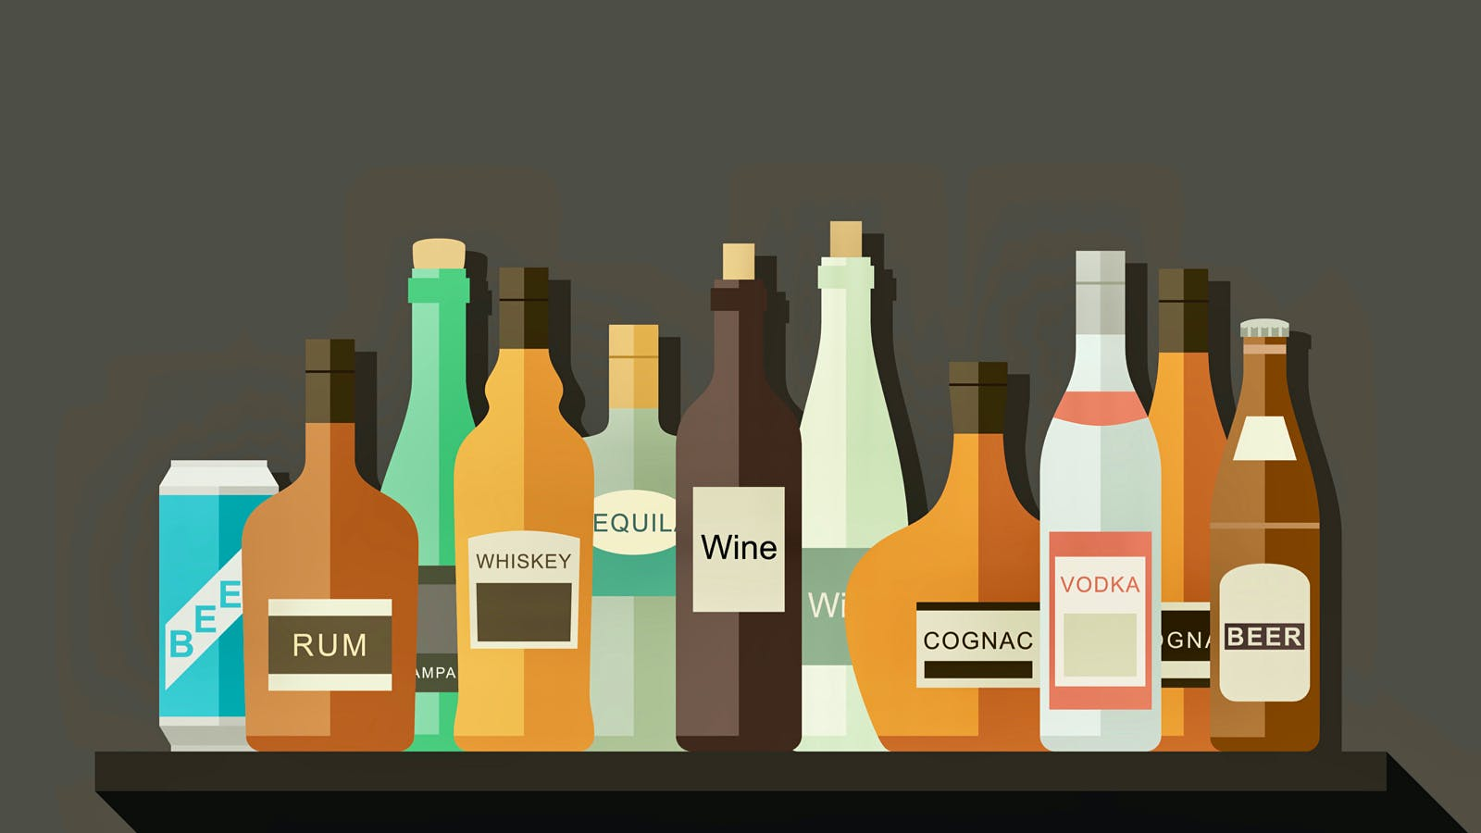
Extract
Dataset 1: “Life Expectancy (WHO),
Statistical Analysis on factors influencing Life Expectancy”
https://www.kaggle.com/kumarajarshi/life-expectancy-who
Dataset 2: “Happiness and Alcohol Consumption,
Alcohol consumption versus Happiness Score ( and another social indexes )”
https://www.kaggle.com/marcospessotto/happiness-and-alcohol-consumption
Dataset 3: ”Alcohol Consumption,
Suicide Rate, Income, Employment & Urban Rate”
https://www.kaggle.com/sansuthi/alcohol-consumption

Slide 4
Data Details
Country: Unique identifier
HDI (Human Development Index): Average achievement in key dimensions of human development - health, wealth, education
Happiness Score: Asking sampled people the question: "How would you rate your happiness on a scale of 1-10"
GDP Per Capita: Gross Domestic Product index
Consumption: Amount of alcohol consumed on annual basis in liters
Beer, Spirits, Wine: Types of alcohol consumed in liters per year
Income Per Person: Persons average annual income
Suicide Rate: Suicide, age adjusted, per 100,000 mortality due to self-inflicted injury, per 100,000 standard population, age adjusted
Employ Rate: Percentage of total population, age above 15, that has been employed during the given year
Life Expectancy: Average life expectancy by age

Slide 5
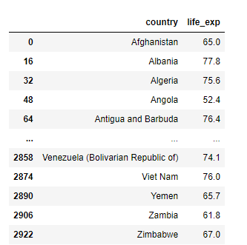
Transform (Dataset 1)

Slide 6
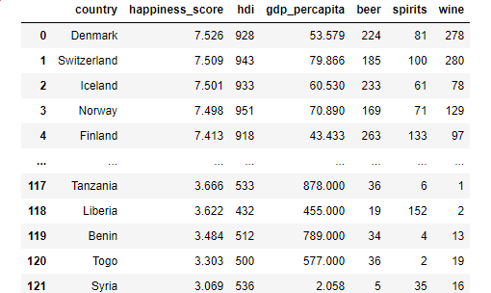
Transform (Dataset 2)

Slide 7
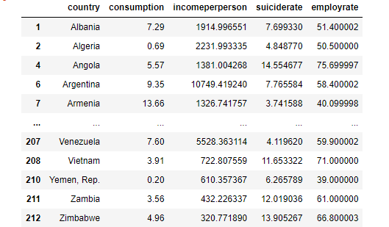
Transform (Dataset 3)

Slide 8
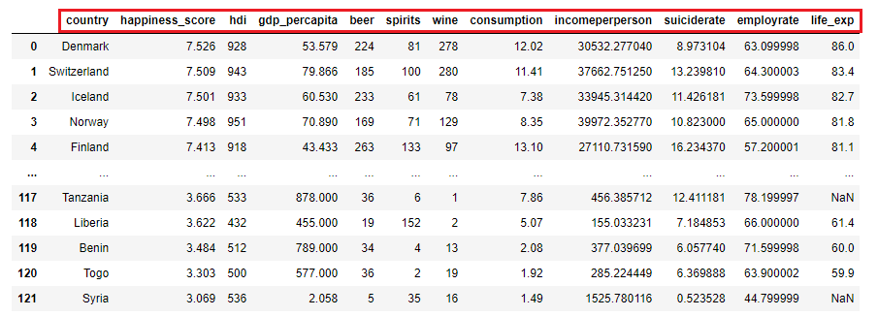
Transform (Final Dataframe)

Slide 9
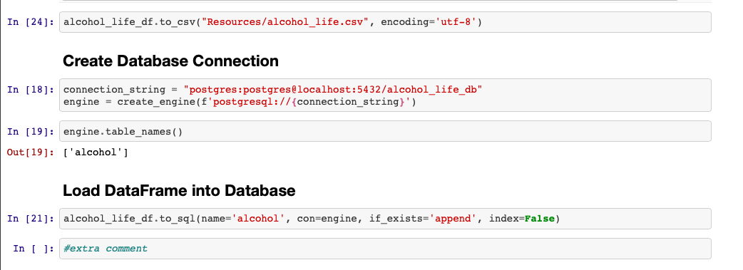
Load
We loaded our data into Postgres

Slide 10
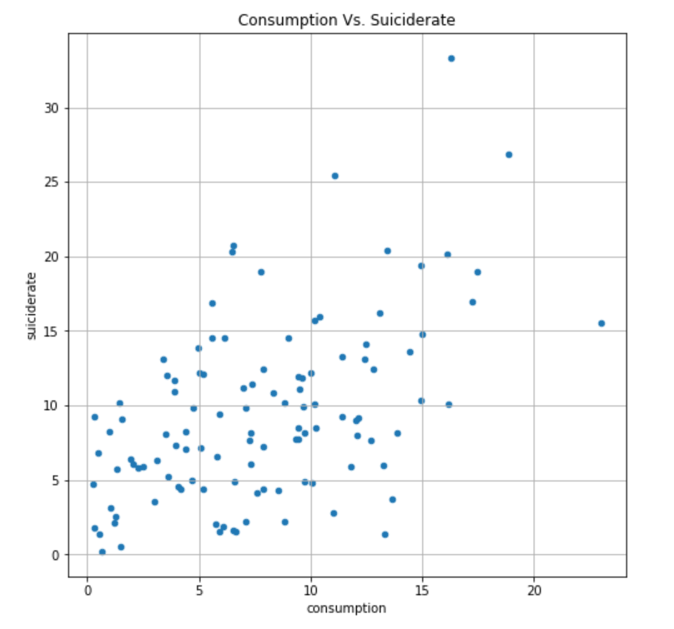
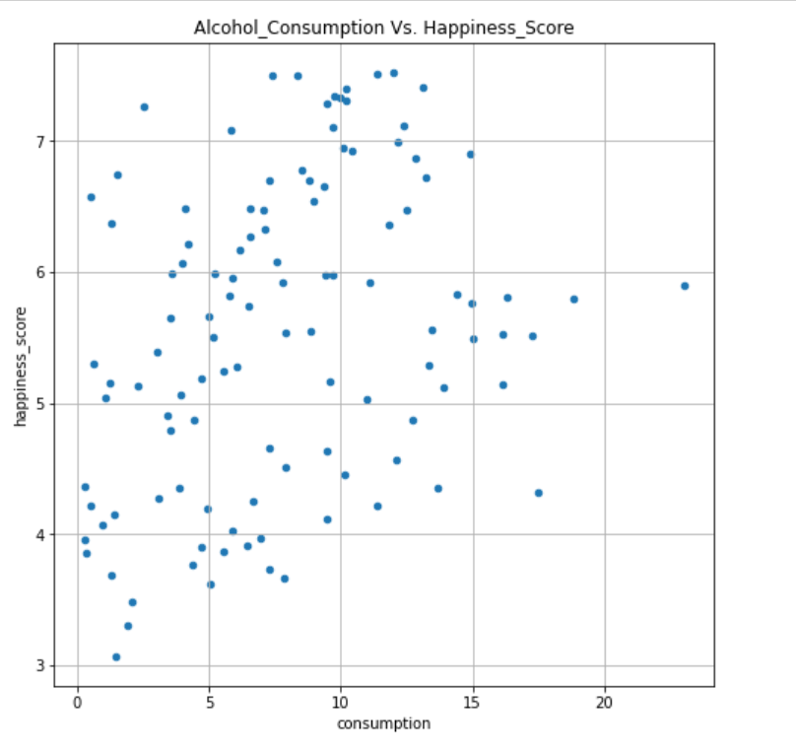
Analysis

Slide 11
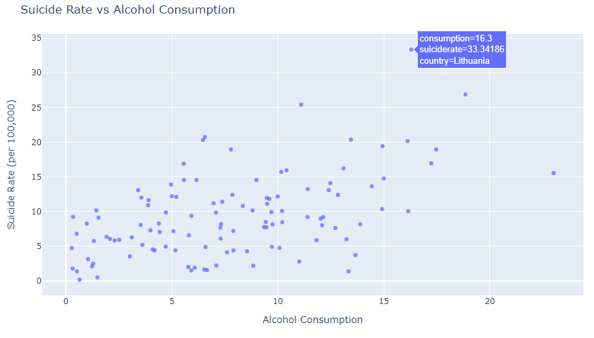

Slide 12
